Slide 1
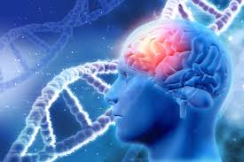
Deep learning model in analysing the Genetic variation associated with the occurrence and progression of Neurodevelopmental disorders

Slide 2
Team Members
COMPUTER SCIENCE | LIFE SCIENCE
Dr. S. Pitchumani Angayarkanni Associate Professor, Department of Computer Science Lady Doak College | Dr. S. Kalaivani Priyadarshini, Assistant Professor, Department of Biotechnology, Lady Doak College
Dr. Sofia, Associate Professor, Department of Computer Science, Lady Doak College. | Ms. Raga Priya UG Student Bioinformatics TN Agricultural university. Coimbatore

Slide 3
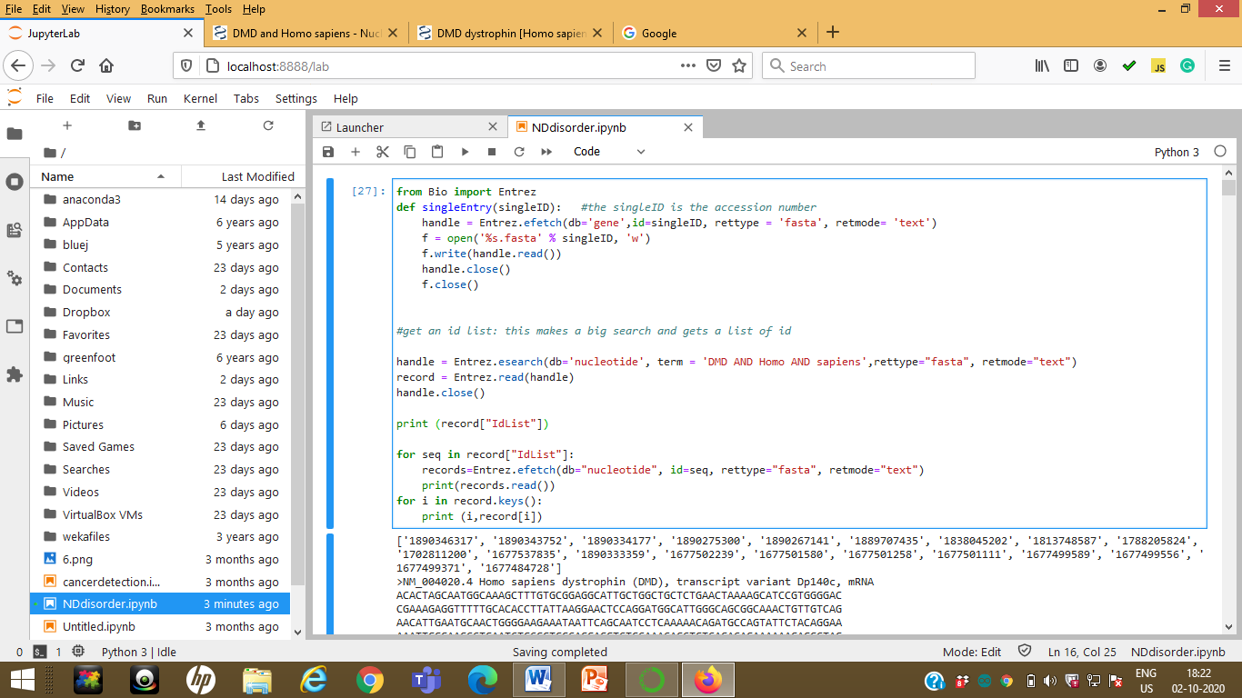
Deep Learning Model Results & Discussion
Previous Week Results
Sequence retrieval

Slide 4
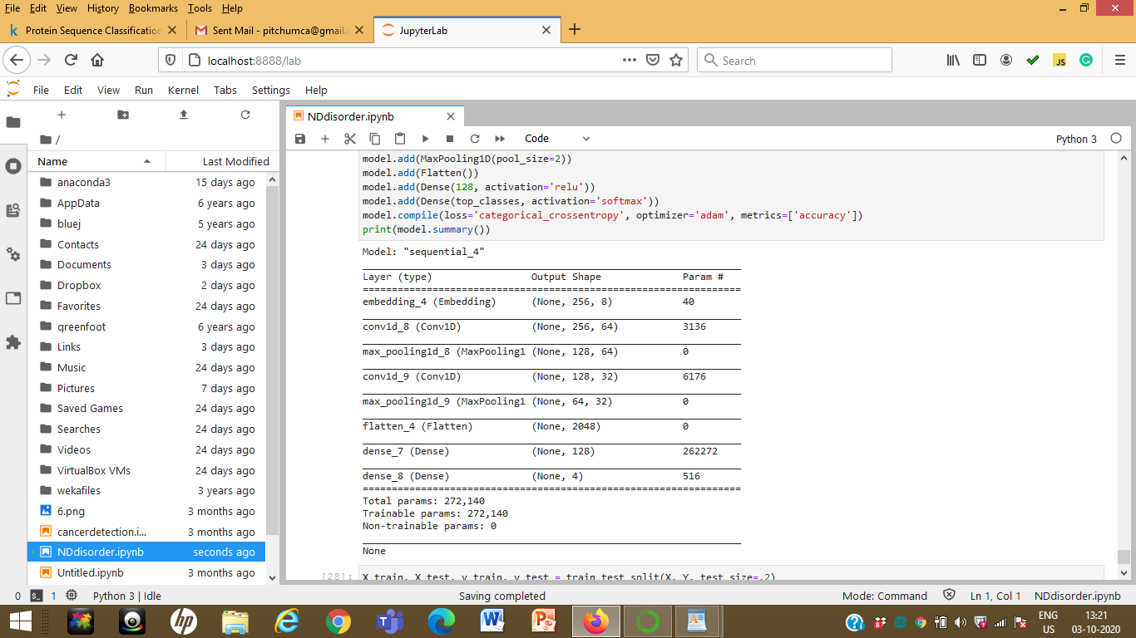

Slide 5
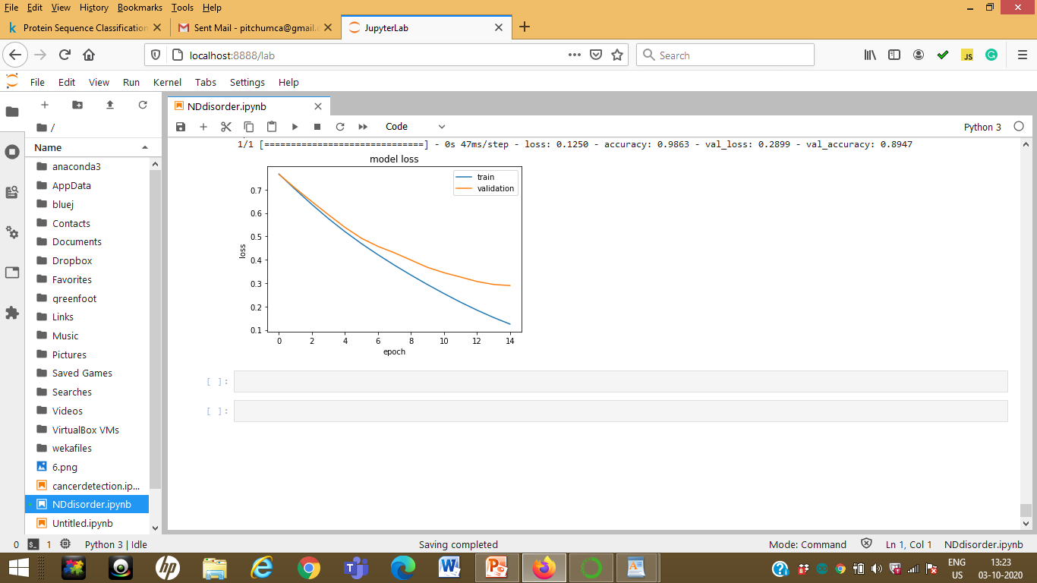

Slide 6
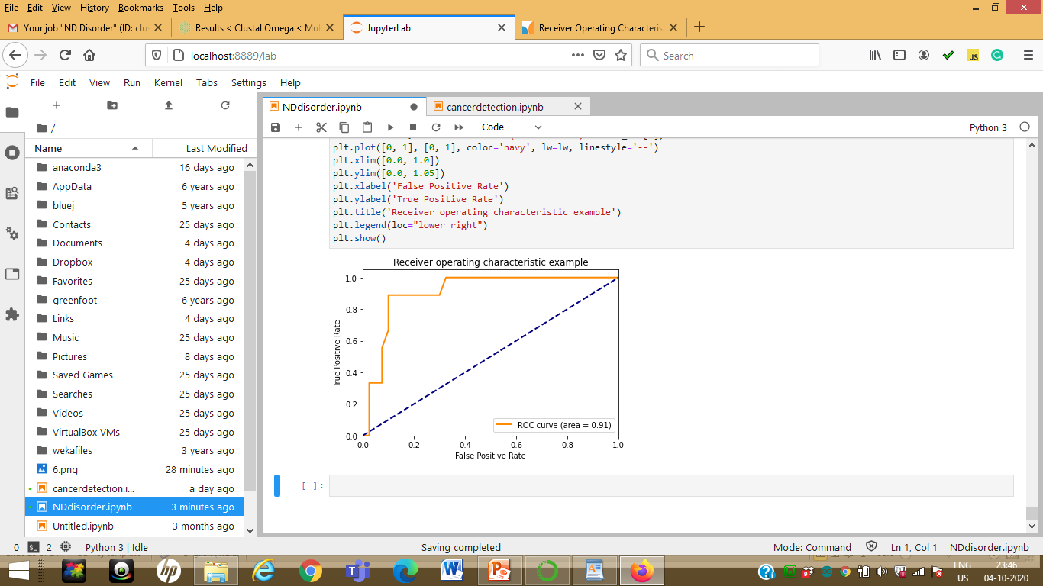

Slide 7
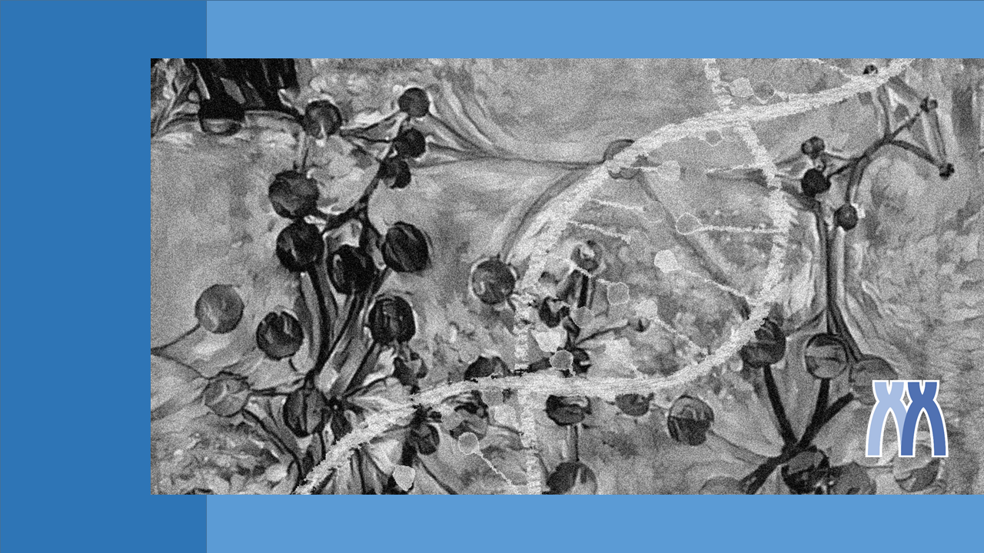
Gene List Analysis Report
Hint: Each slide has notes that explain the analysis!
http://metascape.org
Oct 7, 2020
Notes:
This report is automatically generated by metascape.org based on the gene lists you submitted and the analyses you specified.

Slide 8
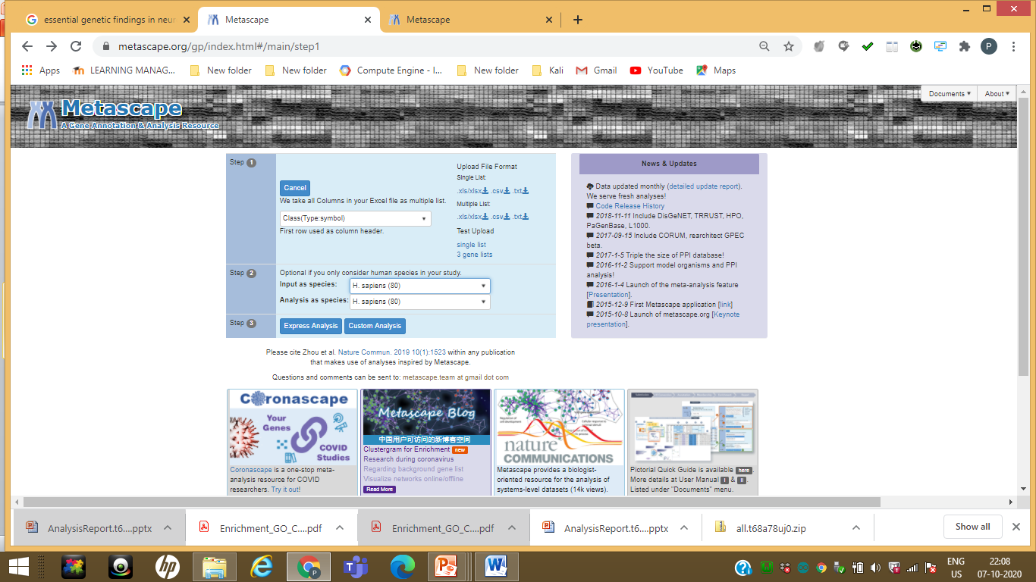

Slide 9
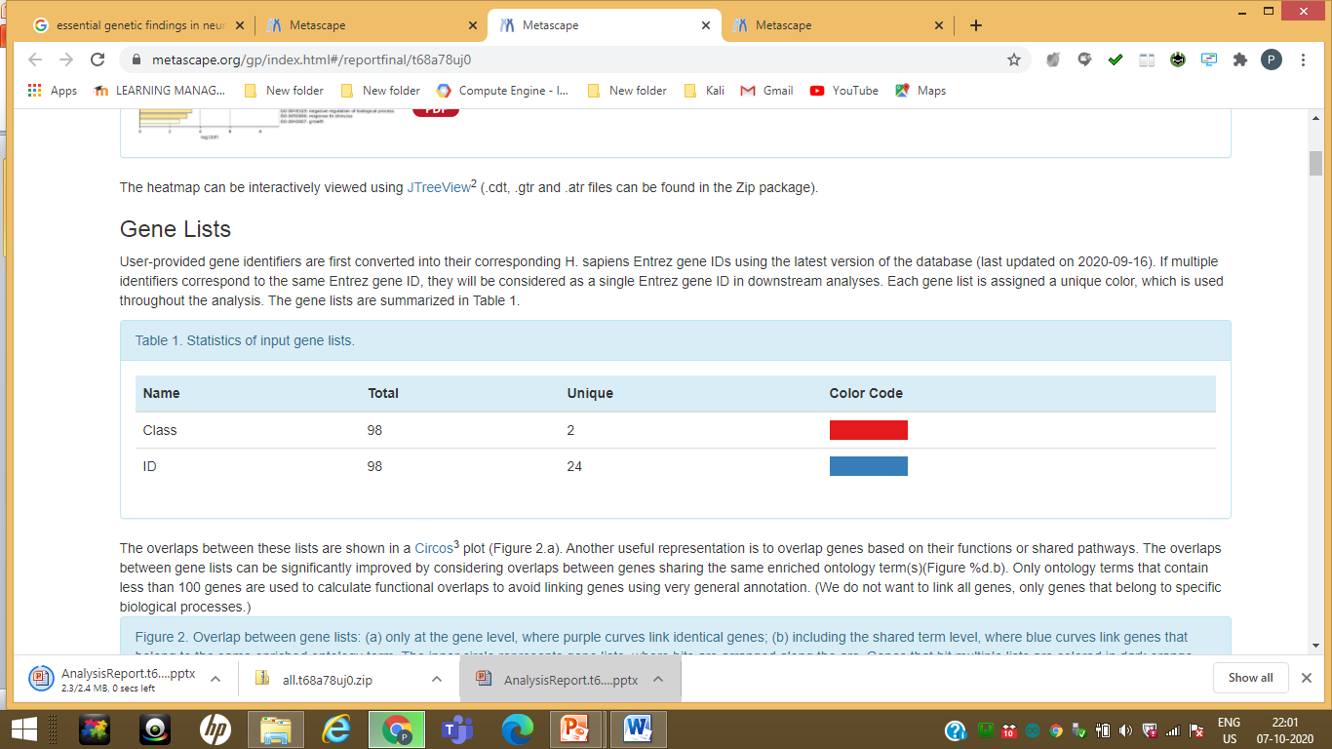

Slide 10
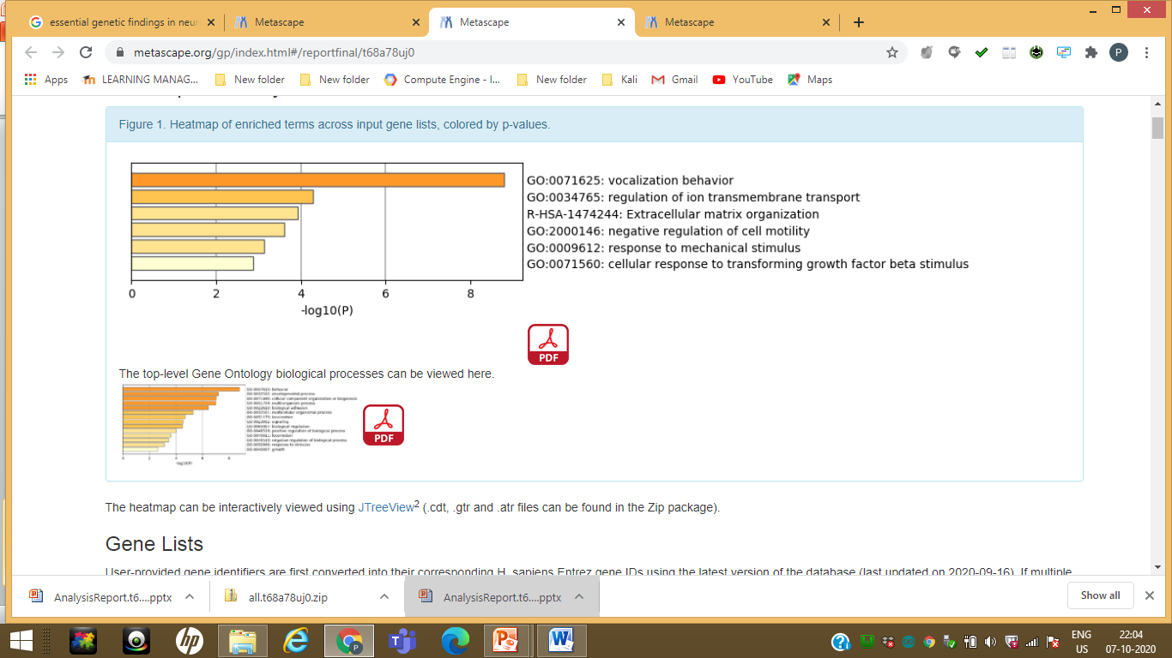
Hierarchically clustered into a tree based on Kappa-statistical similarities among their gene memberships

Slide 11
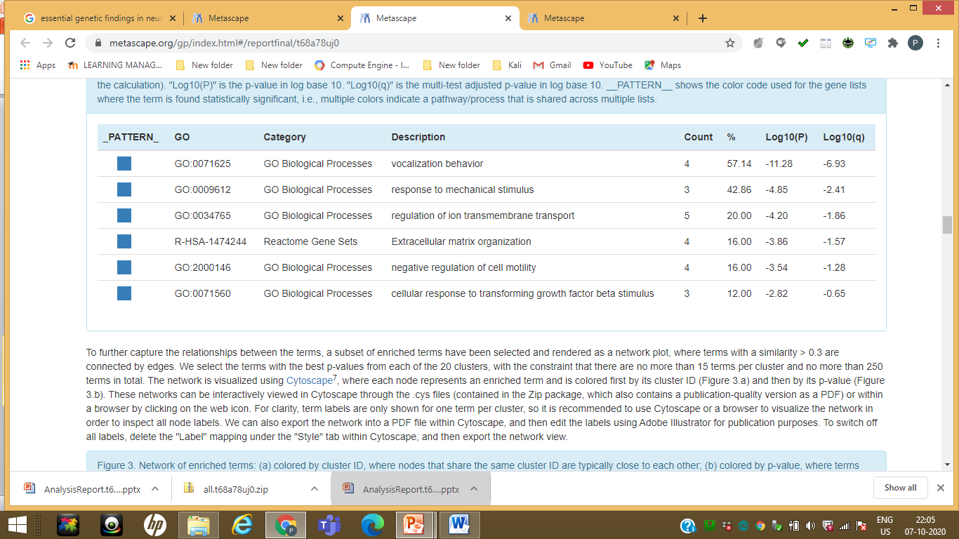

Slide 12
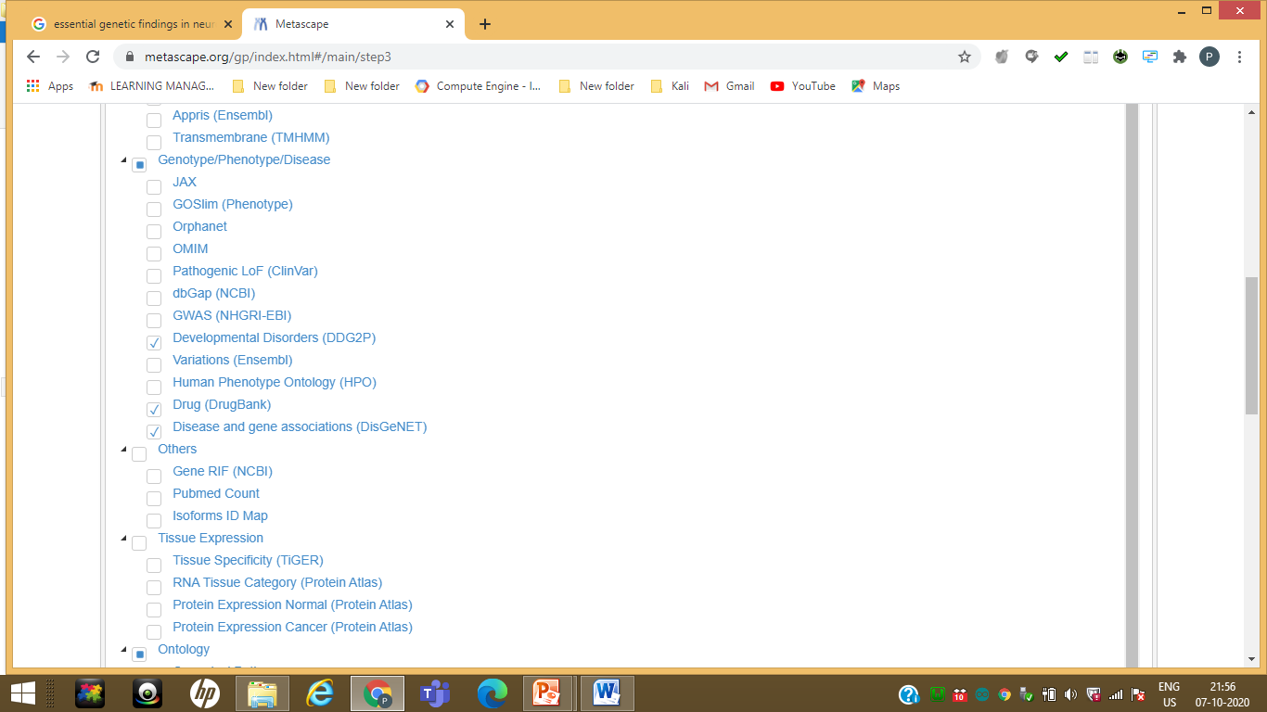

Slide 13
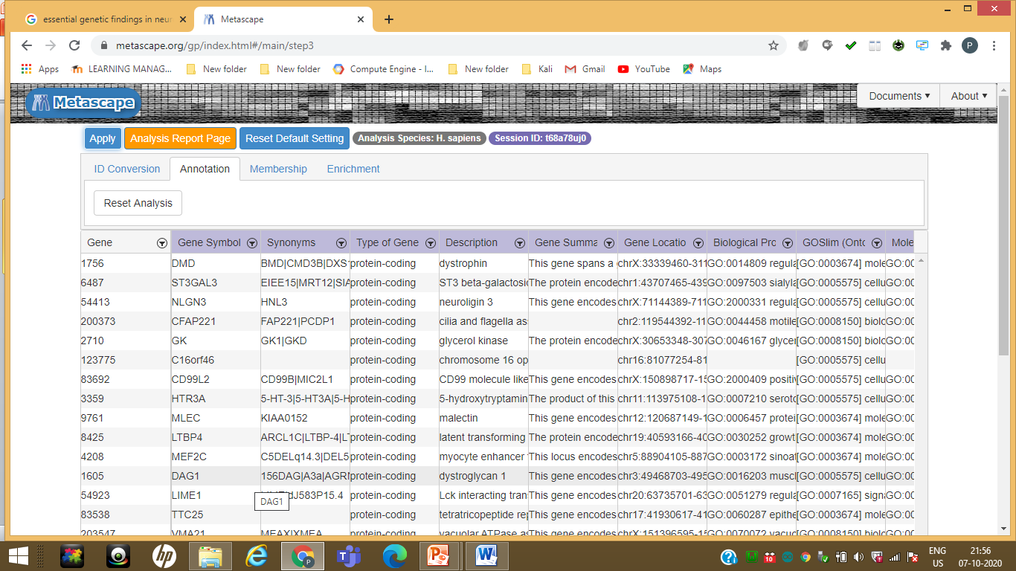

Slide 14
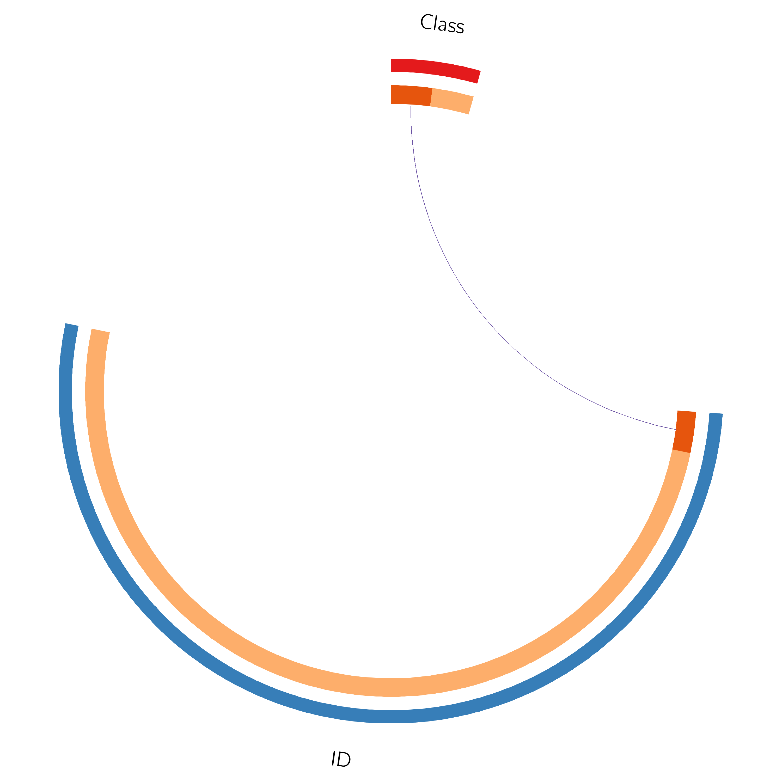
Gene Overlap Analysis
Dark orange color represents the genes that appear in multiple lists and
light orange color represents genes that are unique to that gene list.
Purple lines link the same gene that are shared by multiple gene lists.
The greater the number of purple links and the longer the dark orange arcs implies greater overlap among the input gene lists.
Notes:
The Circos plot shows how genes from the input gene lists overlap.
On the outside, each arc represents the identity of each gene list, using the same color code as the color used for table rows in slide #2.
On the inside, each arc represent a gene list, where each gene has a spot on the arc. Dark orange color represents the genes that appear in multiple lists and light orange color represents genes that are unique to that gene list.
Purple lines link the same gene that are shared by multiple gene lists.
The greater the number of purple links and the longer the dark orange arcs implies greater overlap among the input gene lists.

Slide 15
Gene Overlap Analysis Expanded via Shared Enriched Ontologies
Dark orange color represents the genes that appear in multiple lists and light orange color represents genes that are unique to that gene list.
Purple lines link the same gene that are shared by multiple gene lists.
Blue lines link the different genes where they fall into the same ontology term (the term has to statistically significantly enriched and with size no larger than 100).
The greater the number of purple links and the longer the dark orange arcs implies greater overlap among the input gene lists. Blue links indicate the amount of functional overlap among the input gene lists.
It is common in meta-analysis that we observe little directly overlap among studies, due to the variations in the biological assays tend to see a lot more functional overlap, as these studies probably captured different parts of the same biological processes.
Notes:
The Circos plot shows how genes from the input gene lists overlap.
On the outside, each arc represents the identity of each gene list, using the same color code as the color used for table rows in slide #2.
On the inside, each arc represent a gene list, where each gene has a spot on the arc. Dark orange color represents the genes that appear in multiple lists and light orange color represents genes that are unique to that gene list.
Purple lines link the same gene that are shared by multiple gene lists.
Blue lines link the different genes where they fall into the same ontology term (the term has to statistically significantly enriched and with size no larger than 100).
The greater the number of purple links and the longer the dark orange arcs implies greater overlap among the input gene lists. Blue links indicate the amount of functional overlap among the input gene lists. It is common in meta-analysis that we observe little directly overlap among studies, due to the variations in the biological assays used, however, we tend to see a lot more functional overlap, as these studies probably captured different parts of the same biological processes.

Slide 16
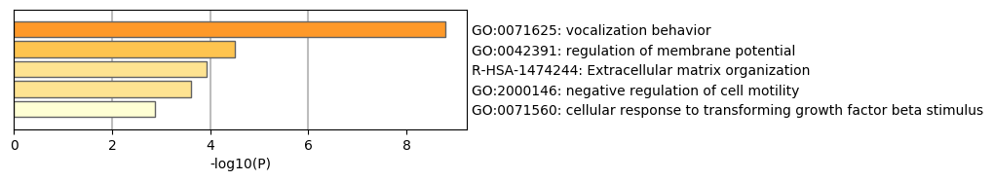
Enriched Ontology Clusters Across Studies
statistically enriched terms (can be GO/KEGG terms, canonical pathways, hall mark gene sets, etc., based on what your choice during the analysis), accumulative hypergeometric p-values and enrichment factors were calculated and used for filtering. Remaining significant terms were then hierarchically clustered into a tree based on Kappa-statistical similarities among their gene memberships (similar to what is used in NCI DAVID site). Then 0.3 kappa score was applied as the threshold to cast the tree into term clusters. The terms within each cluster are exported in the Excel spreadsheet named “Enrichment Analysis”. We selected the term with the best p-value within each cluster as its representative term and display them in a dendrogram. The heatmap cells are colored by their p-values, white cells indicate the lack of enrichment for that term in the corresponding gene list. We also export files behind this heatmap (.cdt, .gtr, .atr, and .jtv files), so that one can visualize it interactively using JTreeView program (http://sourceforge.net/projects/jtreeview/). The PDF version of the graph can be found in the zip package.
Notes:
We first identified all statistically enriched terms (can be GO/KEGG terms, canonical pathways, hall mark gene sets, etc., based on what your choice during the analysis), accumulative hypergeometric p-values and enrichment factors were calculated and used for filtering. Remaining significant terms were then hierarchically clustered into a tree based on Kappa-statistical similarities among their gene memberships (similar to what is used in NCI DAVID site). Then 0.3 kappa score was applied as the threshold to cast the tree into term clusters. The terms within each cluster are exported in the Excel spreadsheet named “Enrichment Analysis”.
We selected the term with the best p-value within each cluster as its representative term and display them in a dendrogram. The heatmap cells are colored by their p-values, white cells indicate the lack of enrichment for that term in the corresponding gene list. We also export files behind this heatmap (.cdt, .gtr, .atr, and .jtv files), so that one can visualize it interactively using JTreeView program (http://sourceforge.net/projects/jtreeview/). The PDF version of the graph can be found in the zip package.

Slide 17
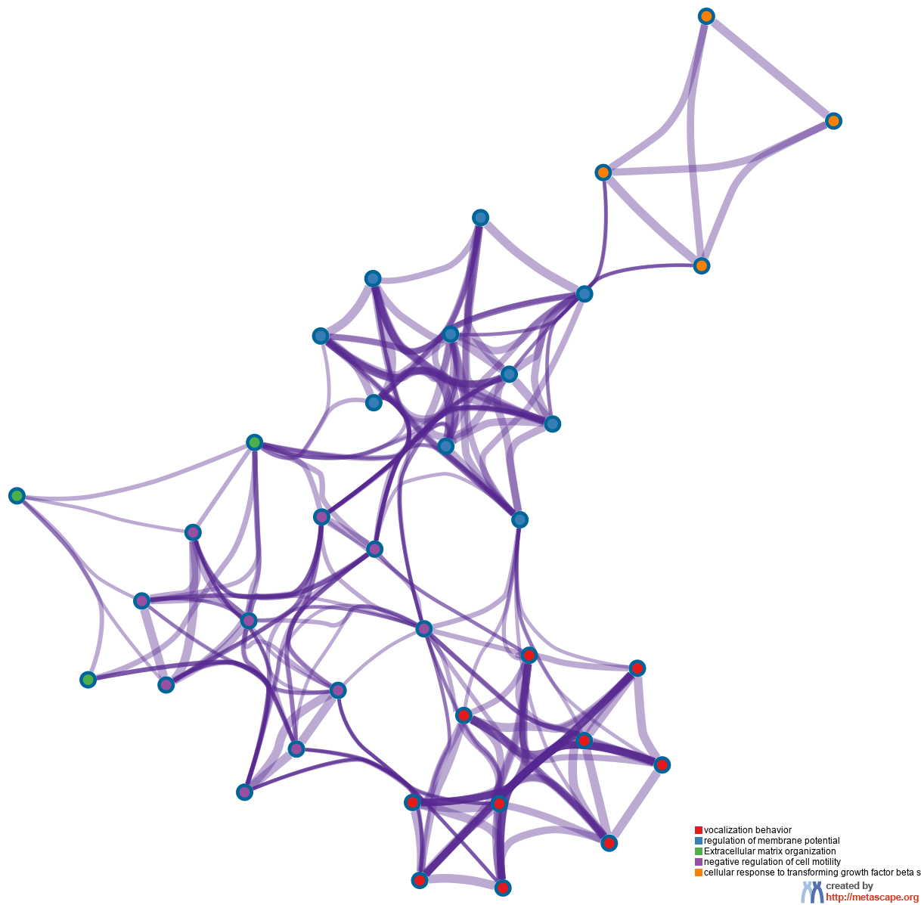
Enriched Ontology Clusters Colored by Cluster ID
CLUSTER 4
Cellular response to transforming growth factor beta S
CLUSTER 3
Regulation of membrane potential
CLUSTER 1
Vocalization behavior
Negative Regulation
of cell mobility
CLUSTER 2
Extracellular matrix organization
Negative Regulation of cell mobility
Notes:
We selected a subset of representative terms from the full cluster and convert them into a network layout. More specifically, each term is represented by a circle node, where its size is proportional to the number of input genes fall into that term, and its color represent its cluster identity (i.e., nodes of the same color belong to the same cluster). Terms with a similarity score > 0.3 are linked by an edge (the thickness of the edge represents the similarity score). The network is visualized with Cytoscape (v3.1.2) with “force-directed” layout and with edge bundled for clarity. One term from each cluster is selected to have its term description shown as label.

Slide 18
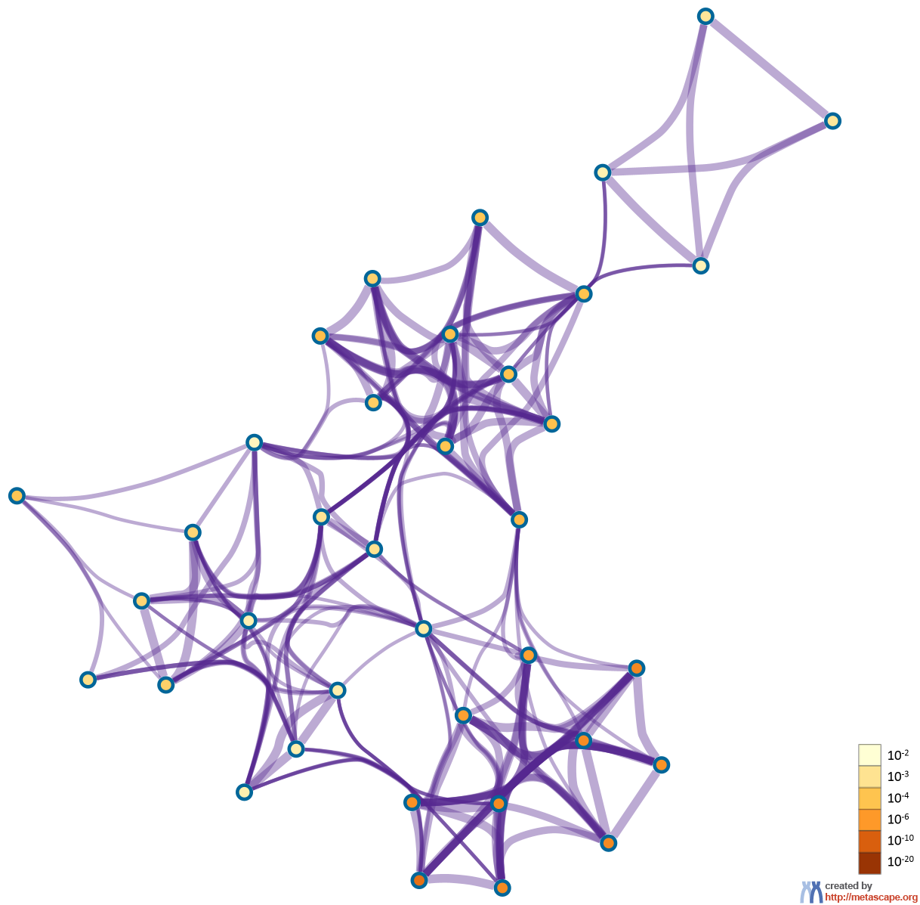
Enriched Ontology Clusters Colored by p-Value
The dark the color, the more statistically significant the node
(see legend for p-value ranges).
Notes:
The same enrichment network has its nodes colored by p-value, as shown in the legend. The dark the color, the more statistically significant the node is (see legend for p-value ranges).

Slide 19
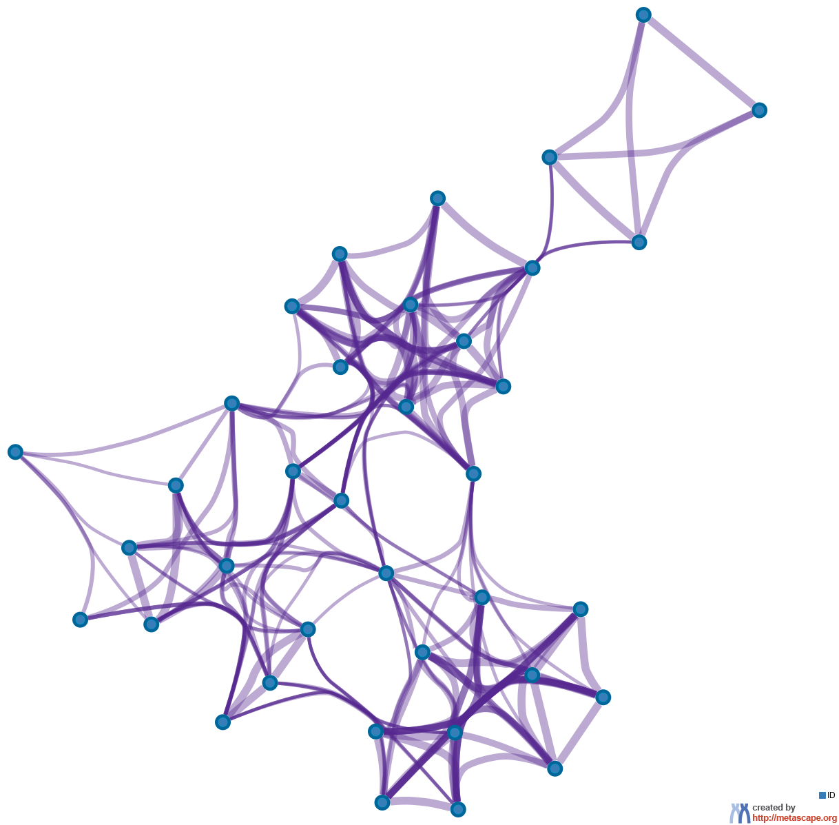
Enriched Ontology Clusters Pied by Gene Counts Across Studies
The same enrichment network has its nodes displayed as pies. Each pie sector is proportional to the number of hits originated from a gene list.
Color code for pie sector represents a gene list and is consistent with the colors used for table rows in slide #2.

Slide 20
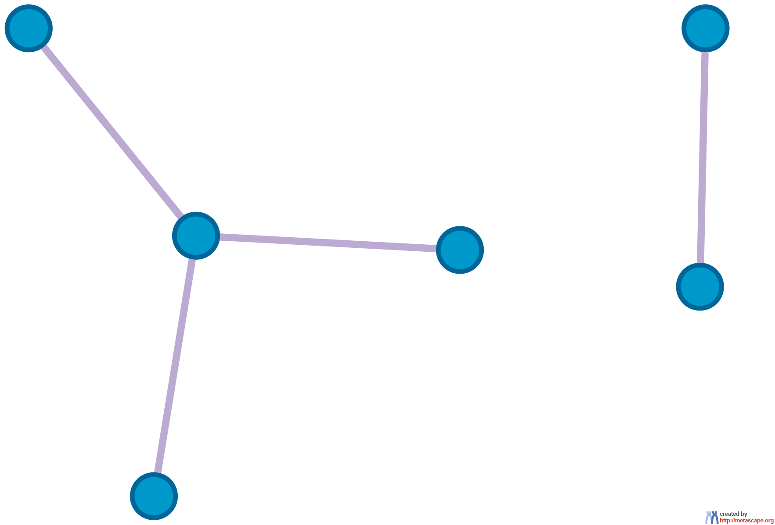
Protein-protein Interaction Network
Gene List: ID
All protein-protein interactions among each input gene list were extracted from PPI data source and formed a PPI network.
GO enrichment analysis was applied to the network to assign biological “meanings”.

Slide 21
Biological Interpretation PPI Network & MCODE Components
Gene List: ID
Network | Annotation
ID | GO:0097105|presynaptic membrane assembly|-9.2; GO:0097090|presynaptic membrane organization|-9.0; GO:0097104|postsynaptic membrane assembly|-8.9
GO enrichment analysis was applied to each MCODE network to assign “meanings” to the network component, where top three best p-value terms were retained.

Slide 22
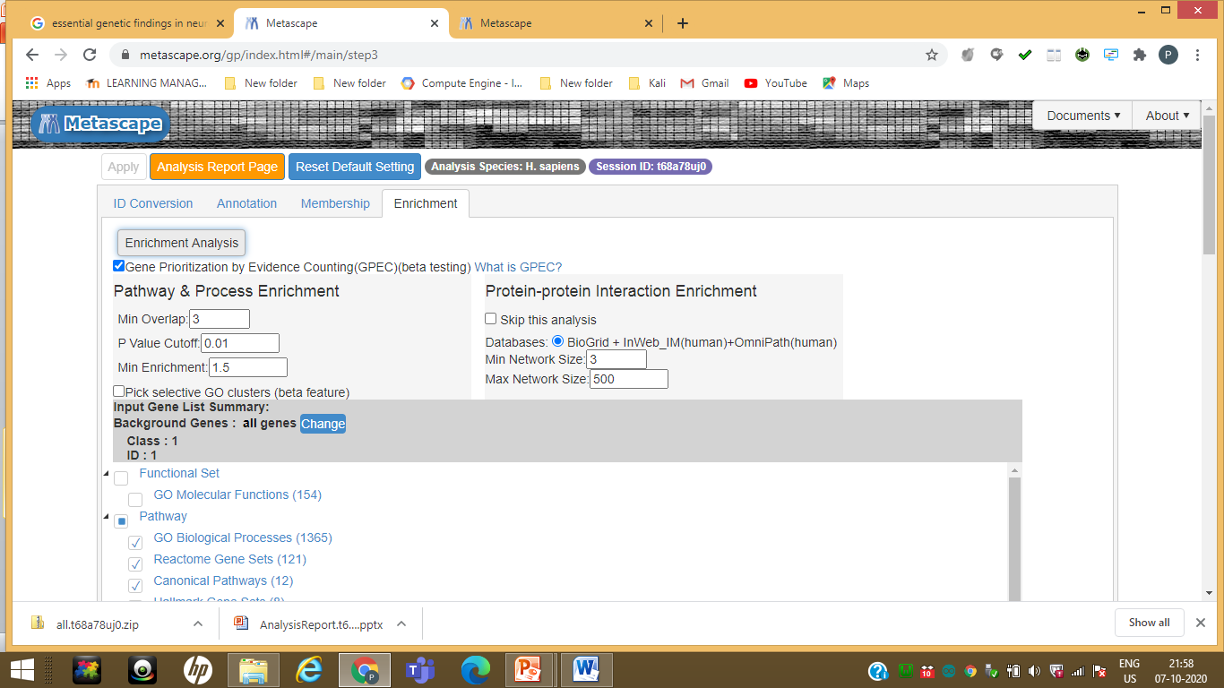

Slide 23
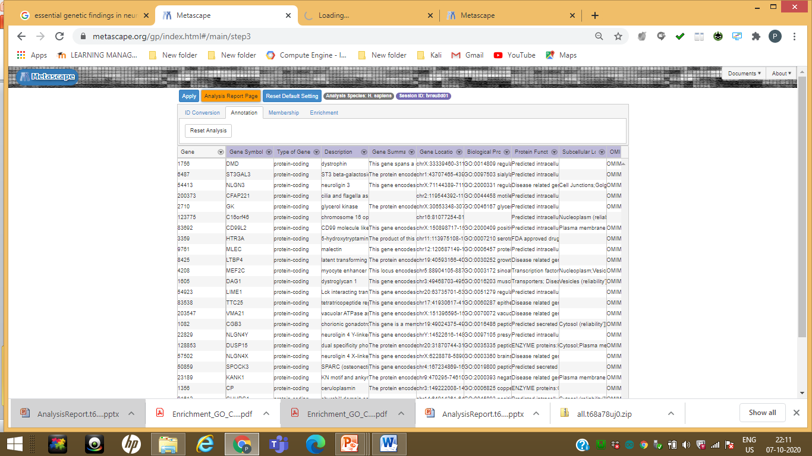

Slide 24
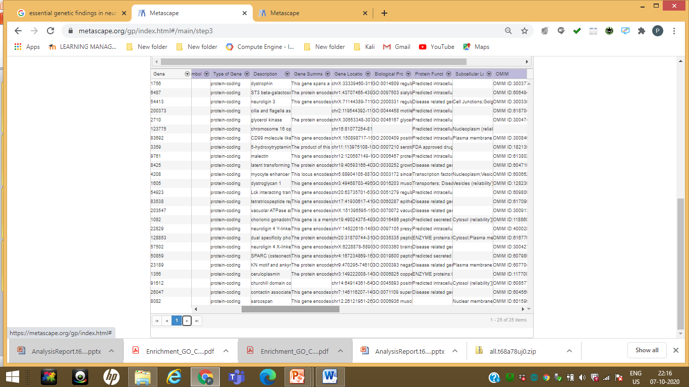

Slide 25
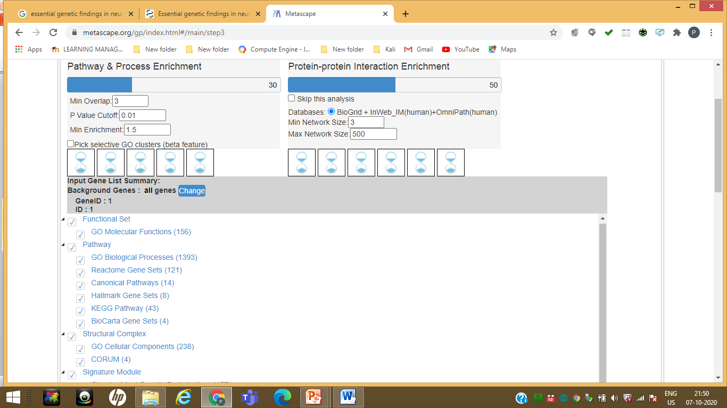

Slide 26
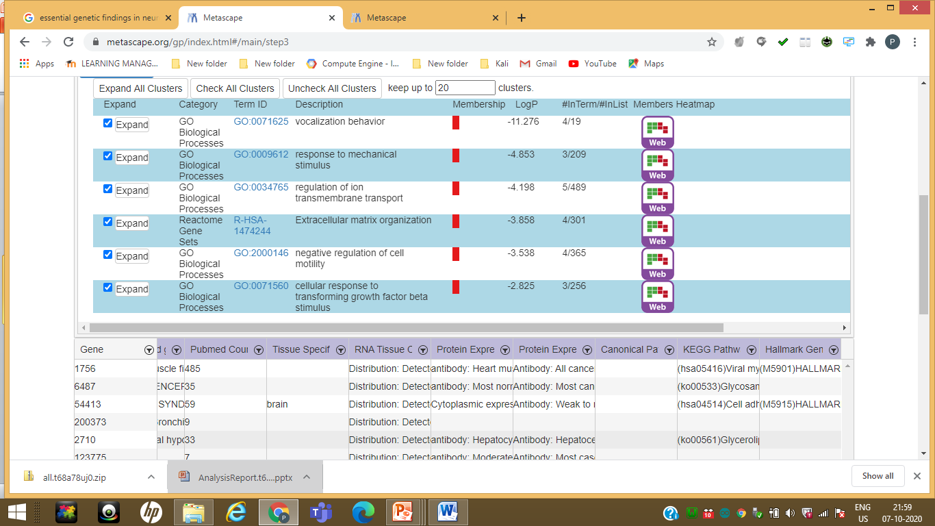

Slide 27
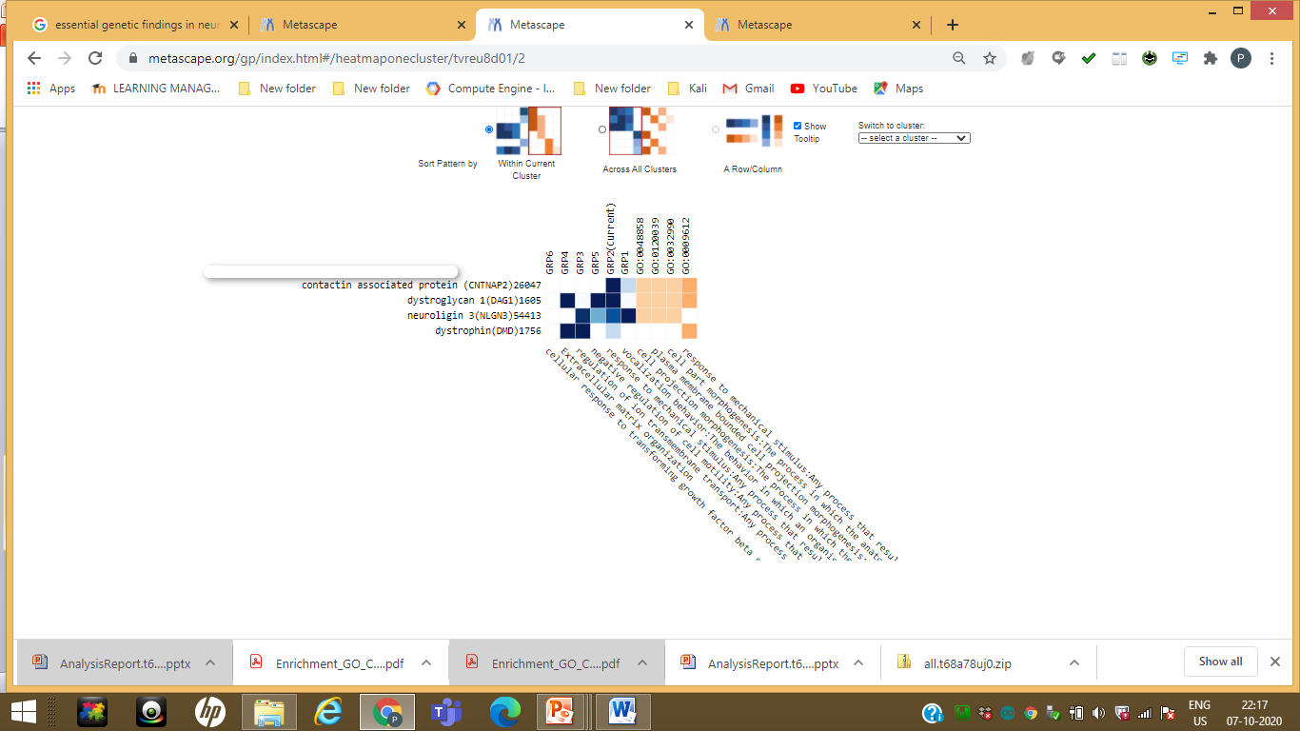

Slide 28
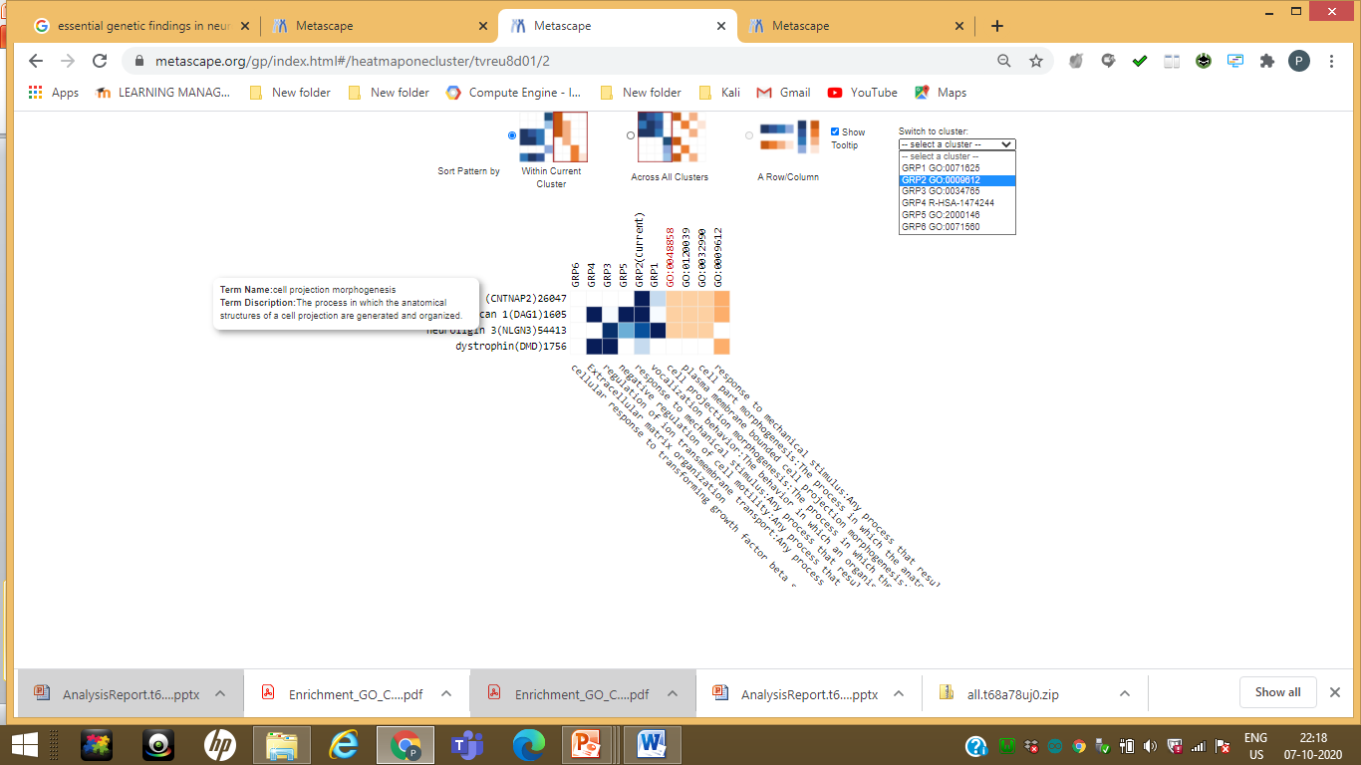

Slide 29
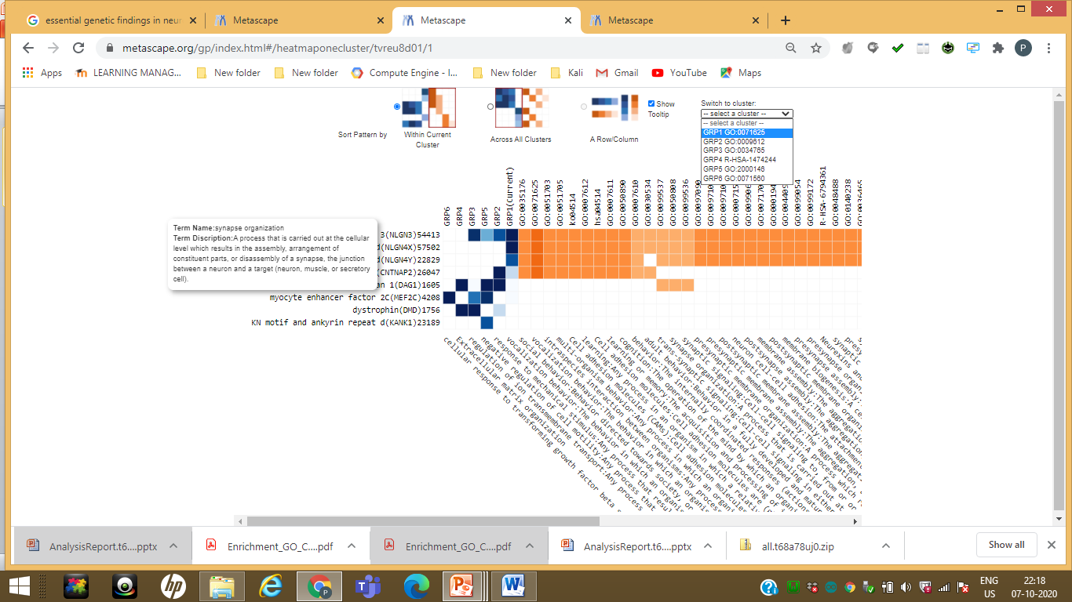

Slide 30
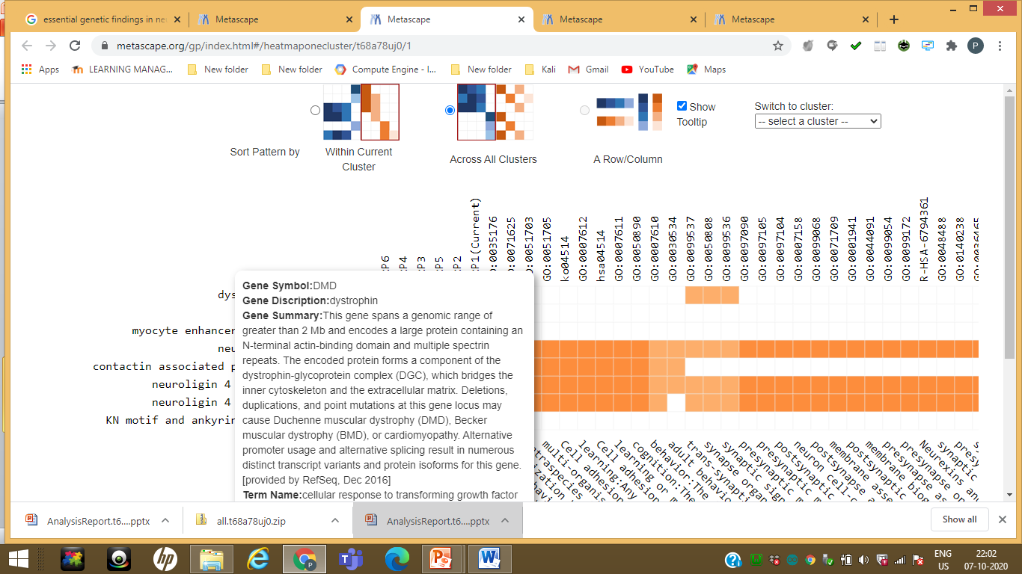

Slide 31
Validation of Gene ID

Slide 32
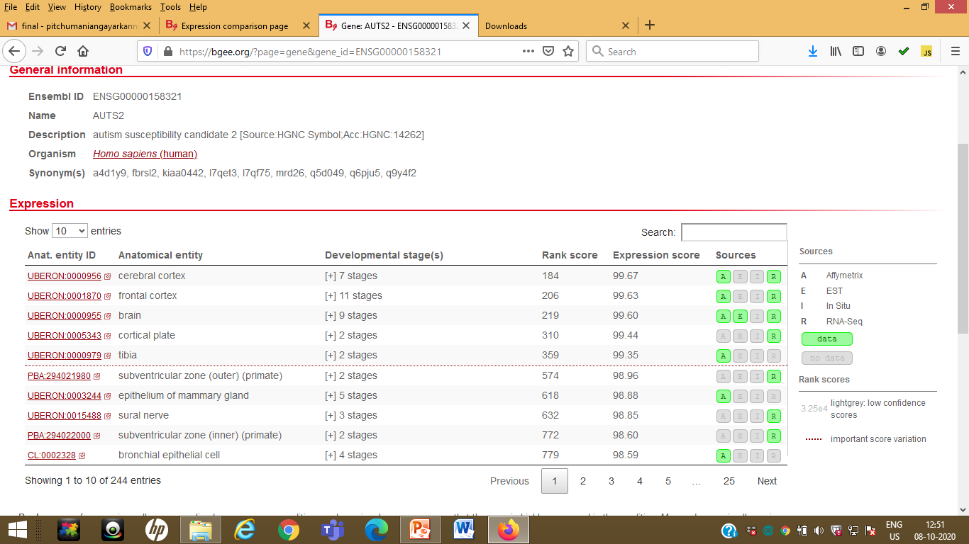
https://bgee.org/?page=gene&gene_id=ENSG00000198947

Slide 33
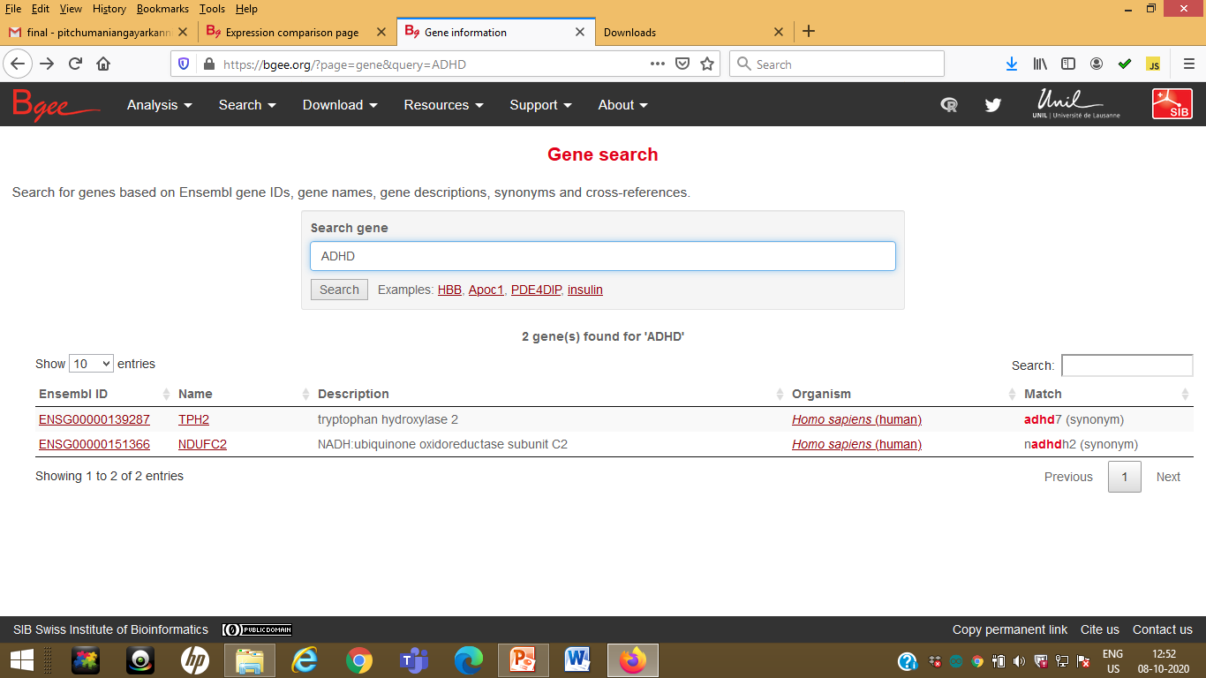

Slide 34
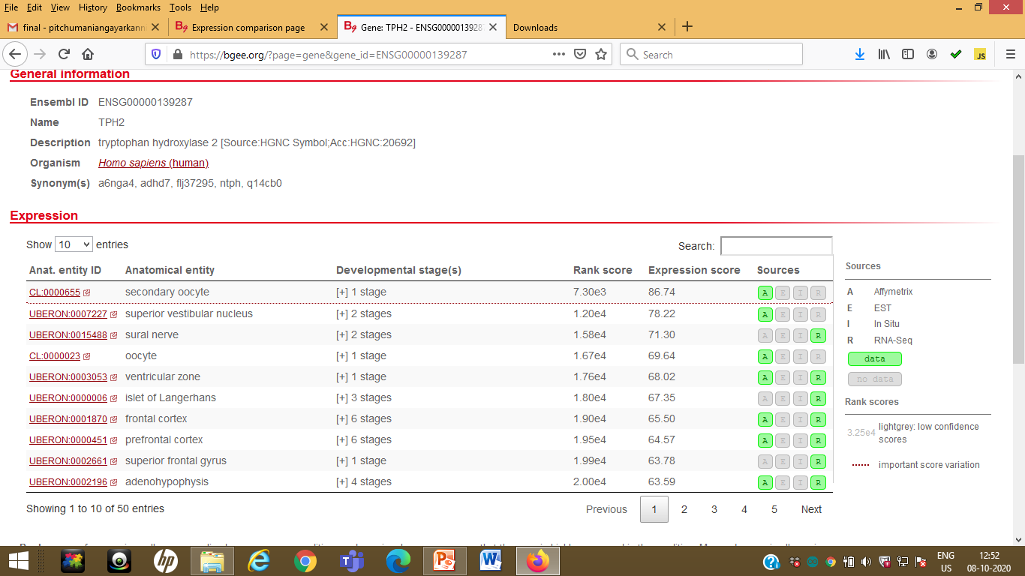

Slide 35
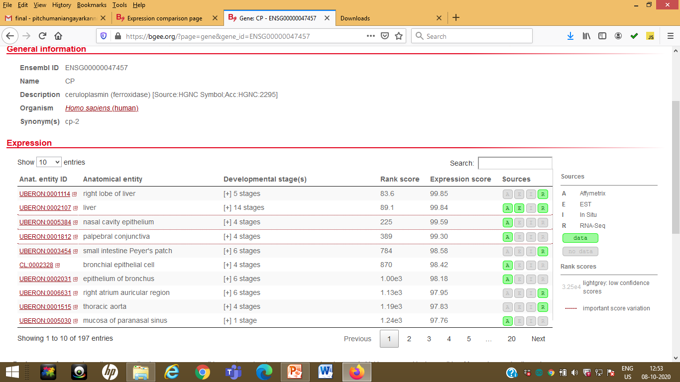

Slide 36
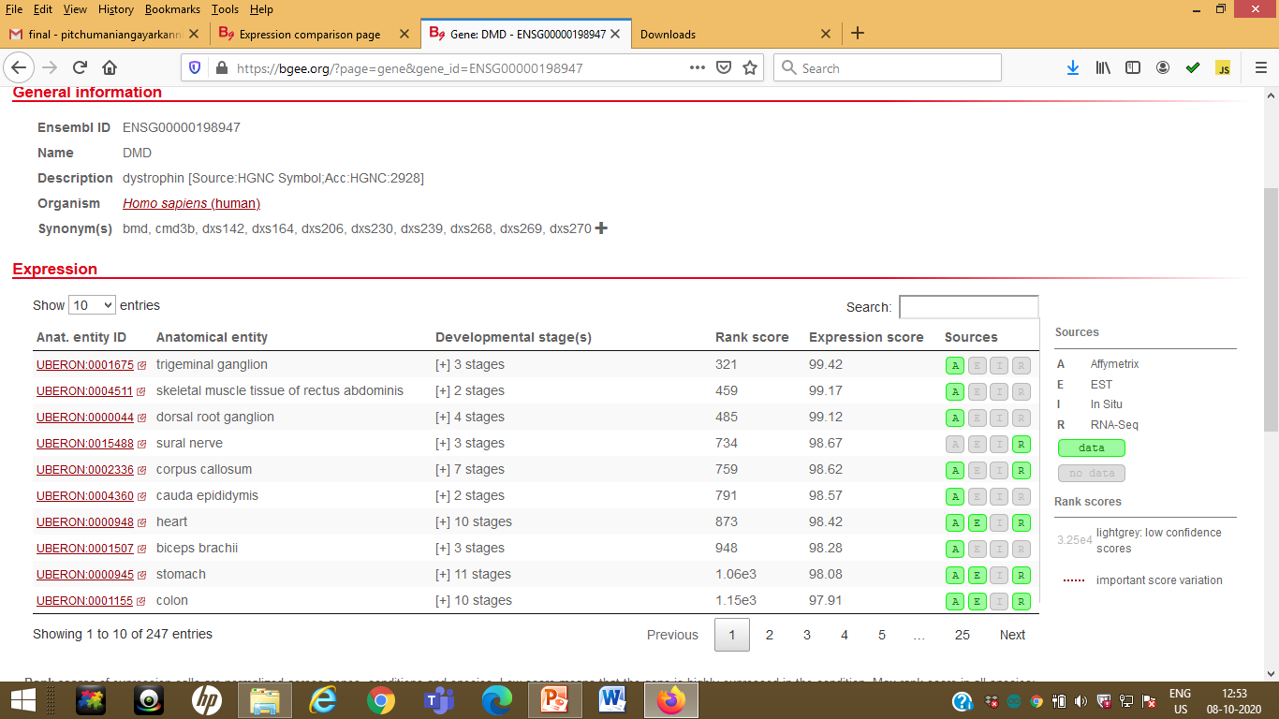

Slide 37
Literature Review of Gene Correlation
https://www.sciencedaily.com/releases/2019/11/191126121153.htm | Autism and ADHD are different developmental disorders, but they can have certain common symptoms. children with autism can demonstrate violent or aggressive behaviour, be impulsive, and have problems in school and with social relations -- and these same symptoms can be shared by children with ADHD The gene that is most frequently affected by mutations in people with ADHD or autism is the so-called MAP1A gene. The gene is involved in the formation of the physical structure of nerve cells -- their inner 'skeleton', so to speak -- and is important for the development of the brain
https://www.sciencedaily.com/releases/2018/05/180510101316.htm | cerebral palsy overlap with those disruptions seen in autism
https://onlinelibrary.wiley.com/doi/pdf/10.1111/dmcn.12922 | autistic spectrum disorder (ASD) reported tooccur in up to 19% of males with DMD

Slide 38
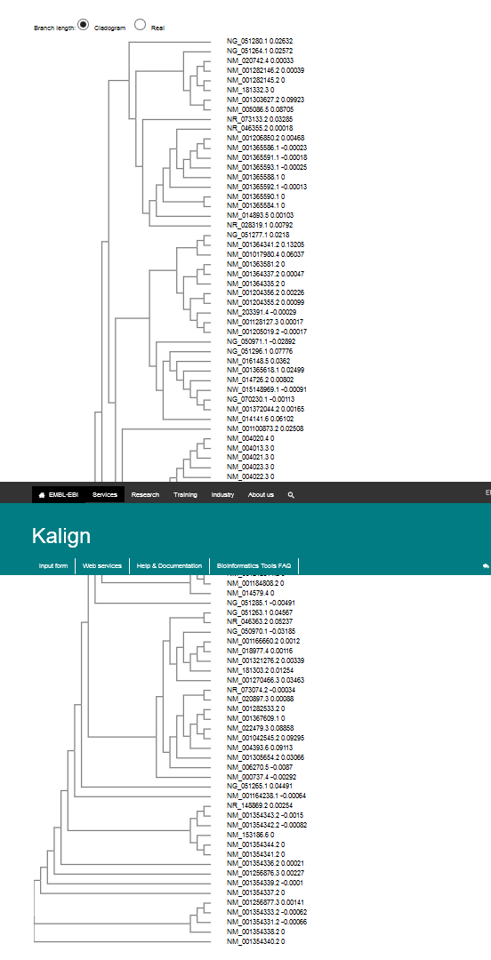
Process Flow
Bio Scrapping Technique to extract Gene Sequence from NCBI
NLP Technique to extract particular gene from description field
99 Nos
Formulated the Gene Sequence Dataset for
NDD
Deployed CNN for NDD Classification
Analysed the Gene Correlation
Accuracy
88.9%

Slide 39
Essential Finding
Developed a new dataset with gene sequence for the four NDD (ADHD,Autism, DMD and CP) using bio scrapping and NLP technique
Developed a deep learning architecture which will classify the percentage of neuro developmental disorder likely to occur from the genetic sequence with an accuracy of 95%
Candidate genes which play a vital role in NDD was identified GRM7, STX1A, CCAR2, EEF1D, GALNT2, SLC44A1, LRRIQ3, AMZ2, CLMN, SEC23IP, INIP, NARG2, FAM234B, MAP1A and TRAP1
Similarity and dissimilarity between the genes in all four disorders was identified

Slide 40
Next Stage
Research Report preparation is in progress

Slide 41


Slide 42
